Slide 1
Digital Portfolio
STUDENT NAME: Rithanya L
REGISTER NO AND NMID:2426k0208and8B529BF2799BF86A3FB43058C1A0D54C
DEPARTMENT: BSC Computer Technology
COLLEGE: KPR College of arts science and research/ Bharathiyar University

Slide 2
Data visualization Dashboard Financial Market Dashboard

Slide 3


AGENDA
Problem Statement
Project Overview
End Users
Tools and Technologies
Portfolio design and Layout
Features and Functionality
Results and Screenshots
Conclusion
Github Link
3/21/2024 Annual Review

Slide 4

PROBLEM STATEMENT
Investors, traders, and financial analysts often struggle with quickly understanding real-time market trends, price fluctuations, and performance metrics of different financial instruments (stocks, cryptocurrencies, commodities, etc.). Most financial data is either scattered across multiple platforms or presented in overly complex tools that are not beginner-friendly.
There is a need for a lightweight, browser-based financial market dashboard that offers a clean, intuitive interface for monitoring real-time and historical data on selected financial assets — all built using basic web technologies (HTML, CSS, JavaScript).

Slide 5

PROJECT OVERVIEW
The Financial Market Dashboard is a simple and responsive web app that shows real-time and past data for stocks and cryptocurrencies. Made with HTML, CSS, and JavaScript, it uses free APIs like CoinGecko or Alpha Vantage to display live prices, daily changes, and trading volume. The dashboard includes interactive charts (with Chart.js) and works well on both phones and computers, making it easy for anyone to track market trends quickly and clearly.

Slide 6

End Users 📈 Tracks real-time and historical data for stocks and cryptocurrencies 💰 Shows live prices, daily changes (%), and trading volume 📊 Includes interactive charts to visualize trends easily 🔍 Lets you search for specific assets 📱 Works on both mobile and desktop devices 🧠 No technical or finance background needed – easy for anyone to use

Slide 7

TOOLS AND TECHNIQUES
.
HTML – Builds the structure of the web app.
CSS – Styles the dashboard and makes it responsive.
JavaScript – Adds functionality and fetches live data.
Chart.js – Creates interactive charts for prices and trends.
CoinGecko API – Provides real-time crypto data.
Alpha Vantage API – Supplies stock market data.

Slide 8
POTFOLIO DESIGN AND LAYOUT
Project Title: Financial Market Dashboard Date & Platform: [Insert Date], Web App Focus Area: Real-Time Market Data, Web Development
🧩 Layout Overview
Intro: Live dashboard for tracking stock & crypto prices
Tools: HTML, CSS, JavaScript, Chart.js
APIs: CoinGecko (crypto), Alpha Vantage (stocks)
Techniques:
Responsive layout (Flexbox, media queries)
Dynamic charts with Chart.js
Real-time data with async JS
Outcome: Built skills in API integration, charting, and responsive design
8

Slide 9
FEATURES AND FUNCTIONALITY
Features & Functionality
📈 Real-Time Data: Live stock and cryptocurrency prices using public APIs.
📊 Interactive Charts: Visualize price trends with Chart.js (line, bar, etc.).
📉 Daily Stats: Shows daily % change, high/low, and trading volume.
🔄 Auto Refresh: Periodically fetches updated data without manual reload.
📱 Responsive Design: Works seamlessly on mobile, tablet, and desktop.
🔍 Asset Search/Selection (Optional): Users can select different assets to view their performance.

Slide 10
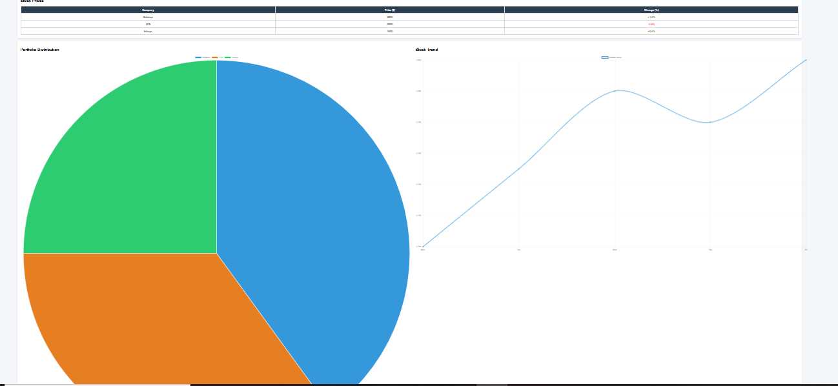

RESULTS AND SCREENSHOTS
Header with title “📊 Financial Dashboard”.
Stock Prices Table (Company, Price, Change %).
Pie Chart – Portfolio distribution.
Line Chart – Stock price trend.
Clean and responsive card-style layout.
.
3/21/2024 Annual Review
10

Slide 11
CONCLUSION
The Financial Dashboard project demonstrates how HTML, CSS, and JavaScript can be used together to create a simple yet effective platform for financial data visualization. With a stock prices table and interactive charts, it provides clear insights into trends and portfolio distribution. The design is clean and responsive, making it easy to use and understand. Though it currently uses static data, it has strong potential to be enhanced with real-time APIs for live stock or cryptocurrency tracking. This makes it both a practical learning project and a foundation for more advanced financial applications.
11

Slide 12
Git hub Link
https://rithanya31649.github.io/naan-mudhalvan0110/

